Slide 1
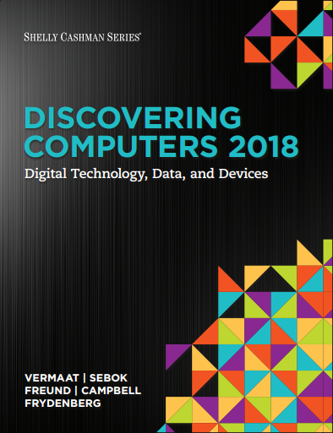

DISCOVERING COMPUTERS 2018 Digital Technology, Data, and Devices
Module 5
Digital Security, Ethics, and Privacy: Threats, Issues, and Defenses
Copyright © 2018 Cengage Learning®. May not be scanned, copied or duplicated, or posted to a publicly accessible website, in whole or in part.

Slide 2
Objectives Overview (1 of 2)
Define the term, digital security risks, and briefly describe the types of cybercriminals
Describe various types of Internet and network attacks, and explain ways to safeguard against these attacks
Discuss techniques to prevent unauthorized computer access and use
Explain the ways that software manufacturers protect against software piracy
Discuss how encryption, digital signatures, and digital certificates work

Slide 3
Objectives Overview (2 of 2)
Identify safeguards against hardware theft, vandalism, and failure
Explain options available for backing up
Identify risks and safeguards associated with wireless communications
Recognize issues related to information accuracy, intellectual property rights, codes of conduct, and green computing
Discuss issues surrounding information privacy

Slide 4
Digital Security Risks (1 of 3)
A digital security risk is any event or action that could cause a loss of or damage to a computer or mobile device hardware, software, data, information, or processing capability
Any illegal act involving the use of a computer or related devices generally is referred to as a computer crime
A cybercrime is an online or Internet-based illegal act

Slide 5
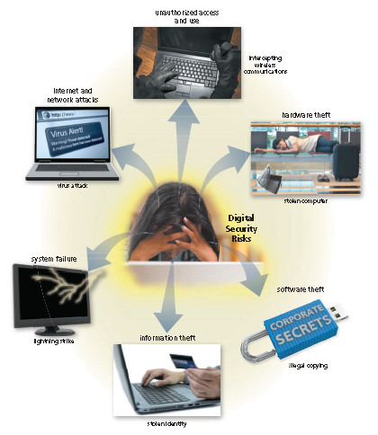
Digital Security Risks (2 of 3)
Figure 5-1 Computers and mobile devices, along with the data and programs they store, are exposed to several types of digital security risks.

Slide 6
Digital Security Risks (3 of 3)
Hacker
Cracker
Script kiddie
Corporate spies
Unethical employees
Cyberextortionist
Cyberterrorist

Slide 7
Internet and Network Attacks (1 of 5)
Information transmitted over networks has a higher degree of security risk than information kept on an organization’s premises
Malware, short for malicious software, consists of programs that act without a user’s knowledge and deliberately alter the operations of computers and mobile devices

Slide 8
Internet and Network Attacks (2 of 5)
Table 5-1 Common Types of Malware
Type | Description
Adware | A program that displays an online advertisement in a banner, pop-up window, or pop-under window on webpages, email messages, or other Internet services.
Ransomware | A program that blocks or limits access to a computer, phone, or file until the user pays a specified amount of money.
Rootkit | A program that hides in a computer or mobile device and allows someone from a remote location to take full control of the computer or device.
Spyware | A program placed on a computer or mobile device without the user’s knowledge that secretly collects information about the user and then communicates the information it collects to some outside source while the user is online.
Trojan horse | A program that hides within or looks like a legitimate program. Unlike a virus or worm, a trojan horse does not replicate itself to other computers or devices.
Virus | A potentially damaging program that affects, or infects, a computer or mobile device negatively by altering the way the computer or device works without the user’s knowledge or permission.
Worm | A program that copies itself repeatedly, for example in memory or on a network, using up resources and possibly shutting down the computer, device, or network.

Slide 9
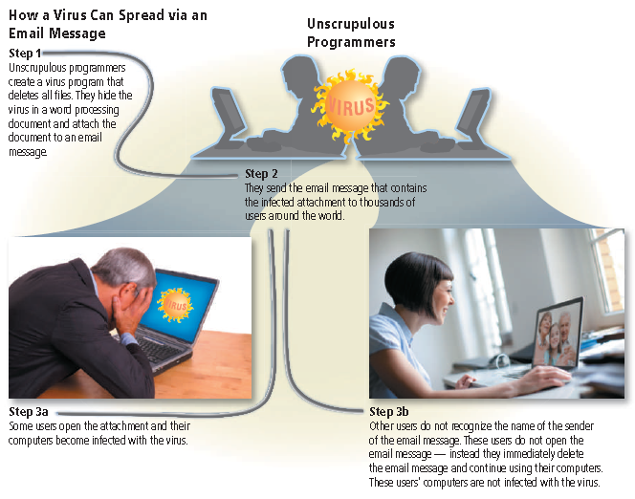
Internet and Network Attacks (3 of 5)
Figure 5-2 This figure shows how a virus can spread via an email message.

Slide 10
Internet and Network Attacks (4 of 5)
A botnet is a group of compromised computers or mobile devices connected to a network
A compromised computer or device is known as a zombie
A denial of service attack (DoS attack) disrupts computer access to an Internet service
Distributed DoS attack (DDoS attack)
A back door is a program or set of instructions in a program that allow users to bypass security controls
Spoofing is a technique intruders use to make their network or Internet transmission appear legitimate

Slide 11
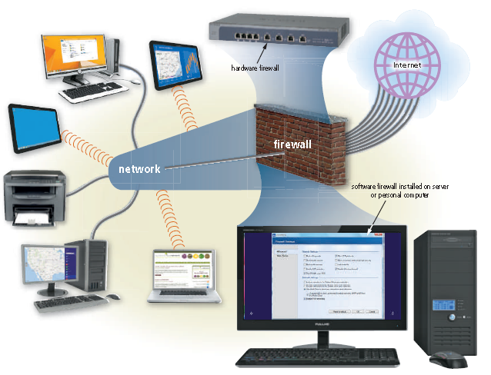
Internet and Network Attacks (5 of 5)
A firewall is hardware and/or software that protects a network’s resources from intrusion
Figure 5-4 A firewall is hardware and/or software that protects a home or business’s network resources from

Slide 12
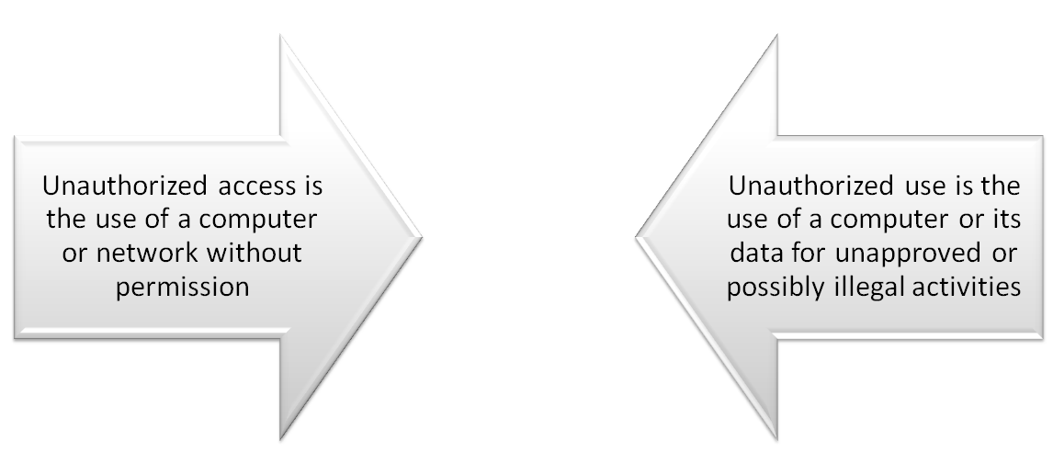
Unauthorized Access and Use (1 of 12)

Slide 13
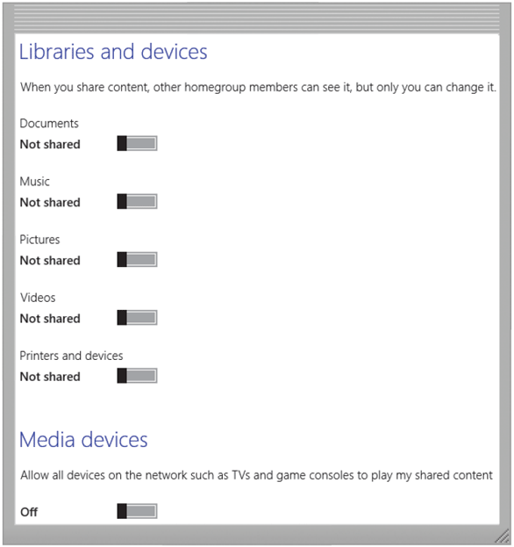
Unauthorized Access and Use (2 of 12)
Organizations take several measures to help prevent unauthorized access and use
Acceptable use policy
Disable file and printer sharing
Figure 5-5 To protect files on your device’s hard drive from hackers and other intruders, turn off file and printer sharing on your device. Source: Microsoft

Slide 14
Unauthorized Access and Use (3 of 12)
Access controls define who can access a computer, device, or network; when they can access it; and what actions they can take while accessing it
The computer, device, or network should maintain an audit trail that records in a file both successful and unsuccessful access attempts
User name
Password

Slide 15
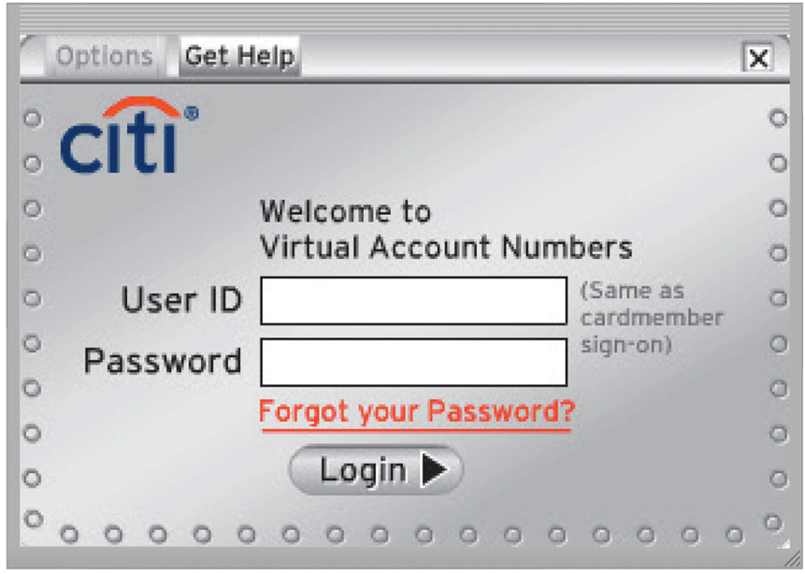
Unauthorized Access and Use (4 of 12)
Figure 5-6 Many websites that maintain personal and confidential data, such as Citibank’s credit card system, require a user to enter a user name (user ID) and password. Source: Citigroup Inc

Slide 16
Unauthorized Access and Use (5 of 12)
A passphrase is a private combination of words, often containing mixed capitalization and punctuation, associated with a user name that allows access to certain computer resources
A PIN (personal identification number), sometimes called a passcode, is a numeric password, either assigned by a company or selected by a user

Slide 17
Unauthorized Access and Use (6 of 12)
A possessed object is any item that you must possess, or carry with you, in order to gain access to a computer or computer facility
A biometric device authenticates a person’s identity by translating a personal characteristic into a digital code that is compared with a digital code stored in a computer or mobile device verifying a physical or behavioral characteristic

Slide 18
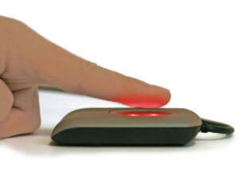
Unauthorized Access and Use (7 of 12)
Fingerprint reader
Figure 5-8 A fingerprint reader.

Slide 19
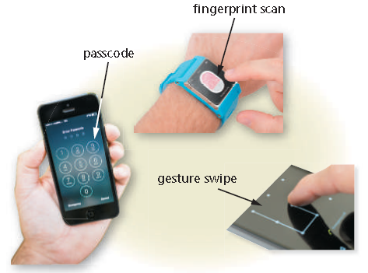
Unauthorized Access and Use (8 of 12)
Face recognition system
Figure 5-9 Some ways users unlock screens include entering a passcode, scanning a fingerprint, and swiping a gesture.

Slide 20
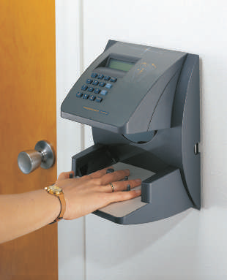
Unauthorized Access and Use (9 of 12)
Hand geometry system
Figure 5-10 A hand geometry system verifies identity based on the shape and
size of a person’s hand. Courtesy of Ingersoll Rand Security Technologies

Slide 21
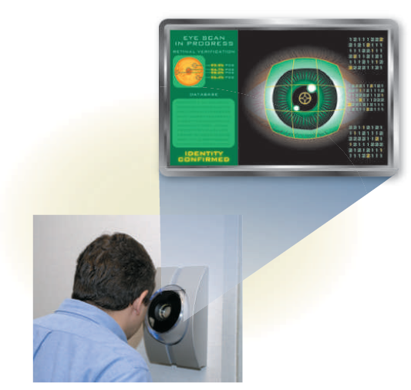
Unauthorized Access and Use (10 of 12)
Iris recognition system
Signature verification system
Voice verification system
Figure 5-10 A hand geometry system verifies identity based on the shape and
size of a person’s hand. Courtesy of Ingersoll Rand Security Technologies

Slide 22
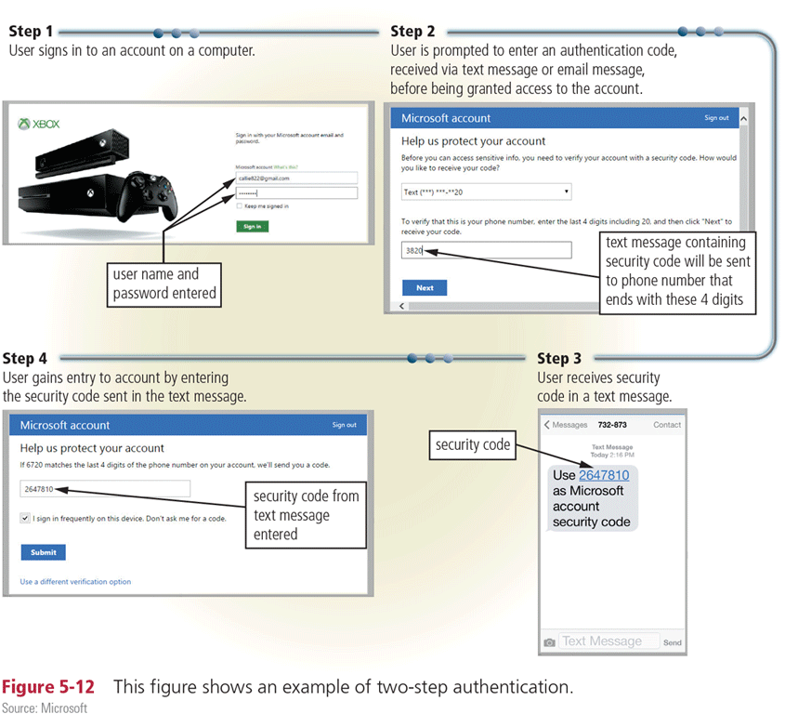
Unauthorized Access and Use (11 of 12)
Two-step verification uses two separate methods, one after the next, to verify the identity of a user
Figure 5-12 This figure shows an example of two-step authentication.
Source: Microsoft

Slide 23
Unauthorized Access and Use (12 of 12)
Digital forensics is the discovery, collection, and analysis of evidence found on computers and networks
Many areas use digital forensics
Law enforcement
Criminal prosecutors
Military intelligence
Insurance agencies
Information security departments

Slide 24
Software Theft (1 of 4)
Software theft occurs when someone:
Steals software media
Intentionally erases programs
Illegally registers and/or activates a program
Illegally copies a program

Slide 25
Software Theft (2 of 4)
Many manufacturers incorporate an activation process into their programs to ensure the software is not installed on more computers than legally licensed
During the product activation, which is conducted either online or by phone, users provide the software product’s identification number to associate the software with the computer or mobile device on which the software is installed

Slide 26
Software Theft (3 of 4)
A license agreement is the right to use software
Typical Conditions of a Single-User License Agreement
You can…
Install the software on only one computer or device. (Some license agreements allow users to install the software on a specified number of computers and/or mobile devices)
Make one copy of the software as a backup
Give or sell the software to another individual, but only if the software is removed from the user’s computer first.

Slide 27
Software Theft (4 of 4)
You cannot…
Install the software on a network, such as a school computer lab.
Give copies to friends and colleagues, while continuing to use the software.
Export the software.
Rent or lease the software.
Figure 5-13 A user must accept the terms of a license agreement before using the software.

Slide 28
Information Theft (1 of 4)
Information theft occurs when someone steals personal or confidential information
Encryption is a process of converting data that is readable by humans into encoded characters to prevent unauthorized access

Slide 29
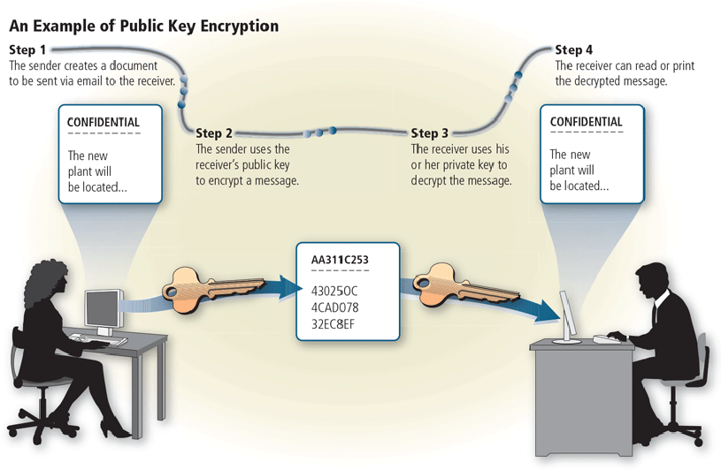
Information Theft (2 of 4)
Figure 5-14 This figure shows an example of public key encryption.

Slide 30
Information Theft (3 of 4)
A digital signature is an encrypted code that a person, website, or organization attaches to an electronic message to verify the identity of the message sender
Often used to ensure that an impostor is not participating in an Internet transaction
A digital certificate is a notice that guarantees a user or a website is legitimate
A website that uses encryption techniques to secure its data is known as a secure site

Slide 31
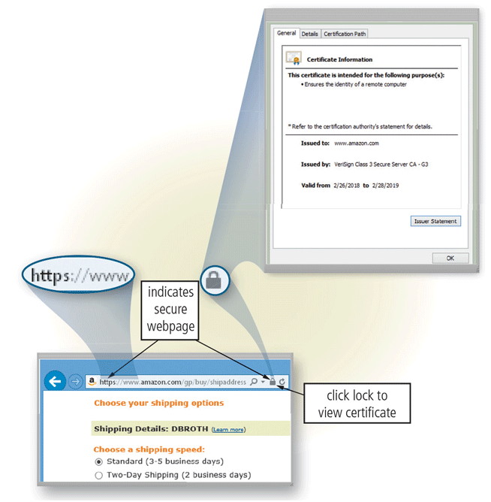
Information Theft (4 of 4)
Figure 5-15 Web addresses of secure sites, such as the Amazon.com checkout, often begin with https instead of http. Browsers also often display a lock symbol in the address bar, which you usually can click to see the associated digital certificate.

Slide 32
Hardware Theft, Vandalism, and Failure (1 of 2)
Hardware theft is the act of stealing digital equipment
Hardware vandalism involves defacing or destroying digital equipment

Slide 33
Hardware Theft, Vandalism, and Failure (2 of 2)
Hardware Theft and Vandalism Safeguards
Physical access controls (i.e., locked doors and windows)
Alarm system
Physical security devices (i.e., cables and locks)
Devices-tracking app
Hardware Failure Safeguards
Surge protector
Uninterruptible power supply (UPS)
Duplicate components or duplicate computers
Fault-tolerant computer
Figure 5-16 Summary of safeguards against hardware theft, vandalism, and failure.

Slide 34
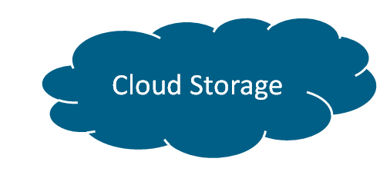
Backing Up – The Ultimate Safeguard (1 of 4)
A backup is a duplicate of a file, program, or media that can be used if the original is lost, damaged, or destroyed
To back up a file means to make a copy of it
Off-site backups are stored in a location separate from the computer or mobile device site

Slide 35
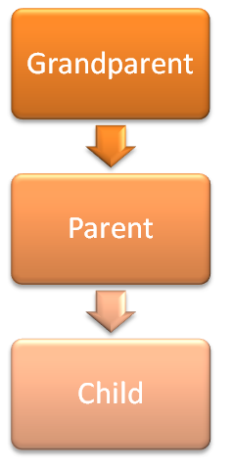
Backing Up – The Ultimate Safeguard (2 of 4)
Categories of backups:
Full
Differential
Incremental
Selective
Continuous data protection
Cloud
Three-generation backup policy

Slide 36
Backing Up – The Ultimate Safeguard (3 of 4)
Table 5-2 Various Backup Methods
Type of Backup | Description | Advantages | Disadvantages
Full backup | Copies all of the files on media in the computer. | Fastest recovery method. All files are saved. | Longest backup time.
Differential backup | Copies only the files that have changed since the last full backup. | Fast backup method. Requires minimal storage space to back up. | Recovery is time-consuming because the last full backup plus the differential backup are needed.
Incremental backup | Copies only the files that have changed since the last full or incremental backup. | Fastest backup method. Requires minimal storage space to back up. Only most recent changes saved. | Recovery is most time-consuming because the last full backup and all incremental backups since the last full backup are needed.

Slide 37
Backing Up – The Ultimate Safeguard (4 of 4)
Type of Backup | Description | Advantages | Disadvantages
Selective backup | Users choose which folders and files to include in a backup. | Fast backup method. Provides great flexibility. | Difficult to manage individual file backups. Least Manageable of all the backup methods.
Continuous data protection (CDP) | All data is backed up whenever a change is made. | The only real-time backup. Very fast recovery of data. | Very expensive and requires a great amount of storage.
Cloud backup | Files are backed up to the cloud as they change. | Cloud backup provider maintains backup hardware. Files may be retrieved or restored from anywhere with an Internet connection and app on any device. | Requires an Internet connection and app, otherwise files are marked for backup when the computer goes back online.

Slide 38
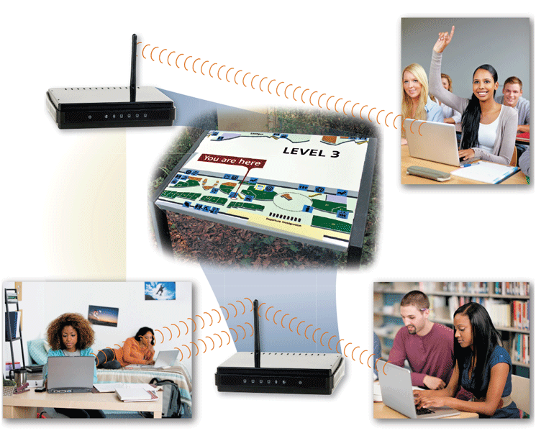
Wireless Security (1 of 2)
Figure 5-18 Wireless access points or routers around campus allow students to access the school network wirelessly from their classrooms, the library, dorms, and other campus locations.

Slide 39
Wireless Security (2 of 2)
Wireless access poses additional security risks
Some perpetrators connect to other’s wireless networks to gain free Internet access or confidential data
Others connect to a network through an unsecured wireless access point (WAP) or combination router/WAP

Slide 40
Ethics and Society (1 of 6)
Technology ethics are the moral guidelines that govern the use of computers, mobile devices, information systems, and related technologies
Information accuracy is a concern
Not all information on the web is correct

Slide 41
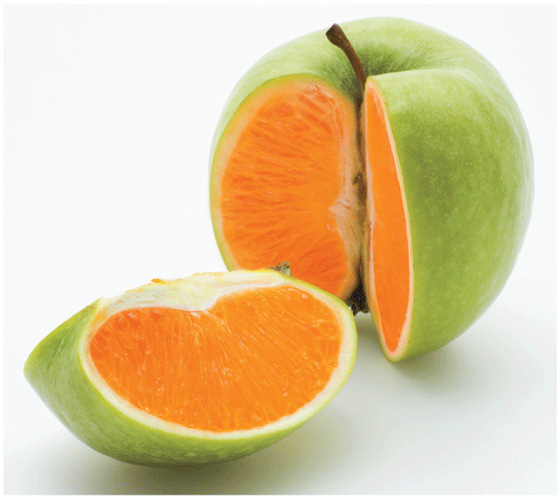
Ethics and Society (2 of 6)
Figure 5-20 This digitally edited photo shows a fruit that looks like an apple on the outside and an orange on the inside.

Slide 42
Ethics and Society (3 of 6)
Intellectual property (IP) refers to unique and original works such as ideas, inventions, art, writings, processes, company and product names, and logos
Intellectual property rights are the rights to which creators are entitled to their work
A copyright protects any tangible form of expression
Digital rights management (DRM) is a strategy designed to prevent illegal distribution of movies, music, and other digital content

Slide 43
Ethics and Society (4 of 6)
A code of conduct is a written guideline that helps determine whether a specification is ethical/unethical or allowed/not allowed
Sample IT Code of Conduct
Technology may not be used to harm other people.
Employees may not meddle in others’ files
Employees may use technology only for purpose in which they have been authorized.
Technology may not be used to steal.
Technology may not be used to bear false witness.

Slide 44
Ethics and Society (5 of 6)
Employees may not copy or use software illegally.
Employees may not use others’ technology resource without authorization.
Employees may not use others’ intellectual property as their own.
Employees shall consider the social impact of programs and systems they design.
Employees always should use technology in a way that demonstrates consideration and respect for fellow humans.

Slide 45
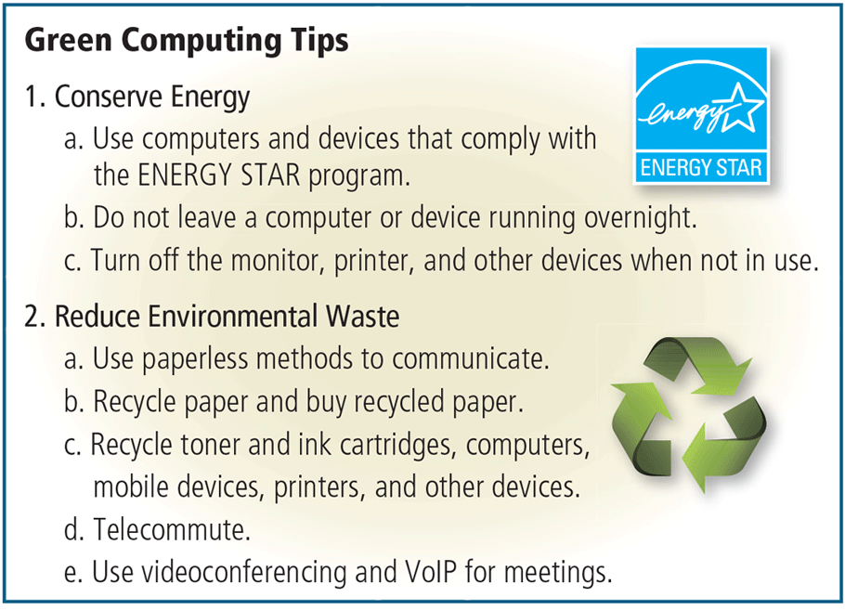
Ethics and Society (6 of 6)
Green computing involves reducing the electricity and environmental waste while using computers, mobile devices, and related technologies
Figure 5-22 A list of suggestions to make computing healthy for the environment.
US Environmental Protection Agency, ENERGY STAR program; Roman Sotola / Shutterstock.com

Slide 46
Information Privacy (1 of 10)
Information privacy refers to the right of individuals and companies to deny or restrict the collection, use, and dissemination of information about them
Huge databases store data online
Websites often collect data about you, so that they can customize advertisements and send you personalized email messages
Some employers monitor your computer usage and email messages

Slide 47
Information Privacy (2 of 10)
How to Safeguard Personal Information
Fill in only necessary information on rebate, warranty, and registration forms.
Do not preprint your phone number or Social Security number on personal checks.
Have an unlisted or unpublished phone number.
If you have Caller ID, find out how to block your number from displaying on the receiver’s system.
Do not write your phone number on charge or credit receipts.
Purchase goods with cash, rather than credit or checks.
Avoid shopping club and buyer cards.

Slide 48
Information Privacy (3 of 10)
Ask merchants not to write credit card numbers, phone numbers, Social Security numbers, and driver’s license numbers on the back of your personal checks.
View or download a copy of the information associated with your Google, Facebook, Microsoft, or other online accounts you access frequently. Disable search history, location history, and usage information sent to these websites.
Inform merchants that you do not want them to distribute your personal information.
Request, in writing, to be removed from mailing lists.
Limit the amount of information you provide to websites. Fill in only required information.
Obtain your credit report once a year from each of the three major credit reporting agencies and correct any errors.

Slide 49
Information Privacy (4 of 10)
Request a free copy of your medical records once a year from the Medical Information Bureau.
Install a cookie manager to filter cookies.
Clear your browsing history when you are finished browsing.
Turn off file and printer sharing on your Internet connection.
Set up a free email account. Use this email address for merchant forms.
Install a personal firewall.
Sign up for email filtering through your ISP or use an anti-spam program.
Do not reply to spam for any reason.
Surf the web anonymously using private browsing.

Slide 50
Information Privacy (5 of 10)
Information about you can be stored in a database when you:
Fill out a printed or online form
Create a profile on an online social network
Register a product warranty

Slide 51
Information Privacy (6 of 10)
A cookie is a small text file that a web server stores on your computer
Websites use cookies for a variety of purposes:
Allow for personalization
Store user names and/or passwords
Assist with online shopping
Track how often users visit a site
Target advertisements

Slide 52
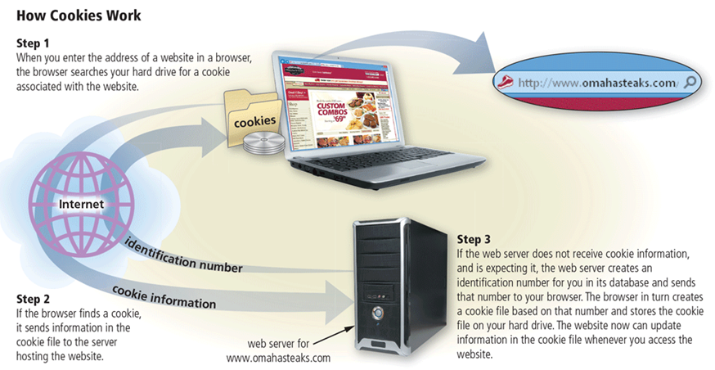
Information Privacy (7 of 10)
Figure 5-25 This figure shows how cookies work.

Slide 53
Information Privacy (8 of 10)
Phishing is a scam in which a perpetrator sends an official looking message that attempts to obtain your personal and/or financial information
With clickjacking, an object that can be tapped or clicked on a website contains a malicious program
Social engineering is defined as gaining unauthorized access to or obtaining confidential information by taking advantage of the trusting human nature of some victims and the naivety of others

Slide 54
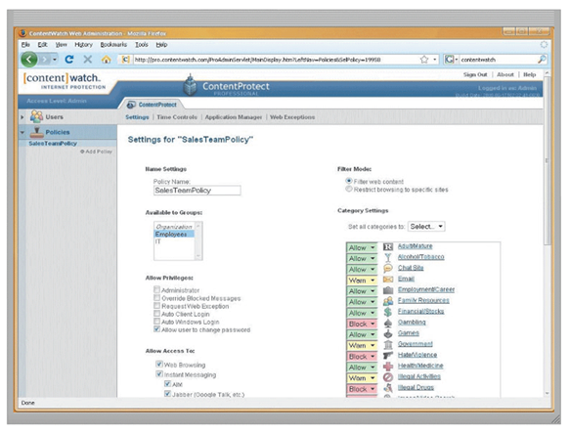
Information Privacy (9 of 10)
Content filtering is the process of restricting access to certain material
Many businesses use content filtering
Web filtering software restricts access to specified websites
Figure 5-26 Web filtering software restricts access to specified websites.

Slide 55
Information Privacy (10 of 10)
Employee monitoring involves the use of computers, mobile devices, or cameras to observe, record, and review an employee’s use of a technology, including communications such as email messages, keyboard activity (used to measure productivity), and websites visited
Many programs exist that easily allow employers to monitor employees. Further, it is legal for employers to use these programs

Slide 56
Summary
Variety of digital security risks
Cybercrime and cybercriminals
Risks and safeguards associated with Internet and network attacks, unauthorized access and use, software theft, information theft, and hardware theft, vandalism, and failure
Various backup strategies and methods of securing wireless communications
Ethical issues in society and various ways to protect the privacy of personal information

